Slide 1
Representations

Slide 2
What do you see?

Slide 6
In a nutshell…
- All media texts are constructed!
- what we see in the media is not real. It is a construction or representation of reality.
-all media texts are constructed through a process of selection, omission and construction

Slide 7
“This is not a pipe”

Slide 8
“This is not a pipe”
Rene Magritte’s “The Trechery of Images” demonstrates the concept of representations
--> it is a depiction of a pipe, but you can’t actually put tobacco in it and smoke it
- everything we see in media is a representations. It has been constructed by someone and is therefore different to reality

Slide 9
What can be represented?
Representations can depict many different thing, including individuals, social groups, institutions, ideas, events and issues…

Slide 17
WHAT IS A CODE?
In Media Studies, the word ‘code’ refers to any system of signs that are used to communicate meaning. When you think about the real world, we are surrounded by signs: traffic lights, written language, mathematics, clothing, body language.

Slide 18
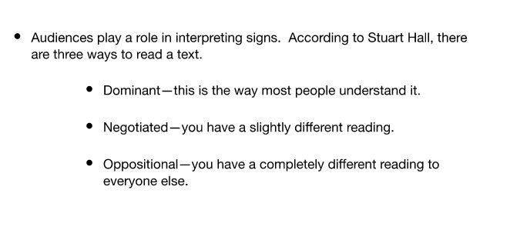

Slide 19
Stuart Hall
→ video

Slide 20
WHAT IS A CONVENTION?
Conventions are well-established ways of constructing texts
“As a type of film or television develops, filmmakers and directors find certain techniques that become useful or effective in creating texts. These techniques get used again and again, and eventually they are associated with and are used to define certain types of texts. The techniques then become known as conventions.”

Slide 21
What media text is this?
Title, tagline, floating heads, first billed cast and crew, release date, classification advice.

Slide 22
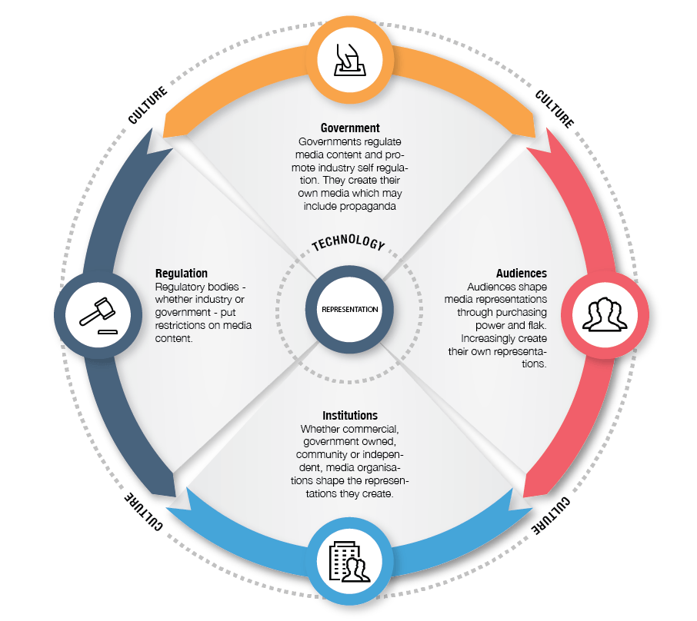
Representations and values
Because representations are created by people who exist in a society and culture, they invariably reflect the values and attitudes of those who create them. This diagram illustrates the factors that can influence the media we create and consume:

Slide 23
Culture. First, we’re all part of a culture. These values and beliefs influence the representations we create.
Government. Governments legislate and regulate the media, putting constraints on what audiences and institutions can create.
Regulation. Regulatory bodies – whether industry bodies such as Ad Standards or government bodies such as the Classification Board – also influence what we see, hear and read in the media.

Slide 24
Institutions. Whether they’re commercial, government, community or independent, media organizations influence the nature of representations in the texts that they create.
Audiences. We increasingly create and communicate our own representations. Our spending influences the texts and representations that media organisations create. So too the flak directed at media organisations who might produce representations that upset or offend.
Technology. Technology also influences the nature of representations that we see.

